Slide 1


INFORMATION RETRIEVAL Assignment-2: Stack Overflow Dataset
Teammates: Sai Sathvick Chirakala
Maitreyi Naik
Nikhila Ratakonda
Instructor: Dr. Fang Jin

Slide 2
Contents
Dataset Introduction
Defining query
Preprocess dataset
TF-IDF
Vector Space
Document Cosine similarity
K-means clustering
Hierarchical clustering

Slide 3
1. Dataset Introduction
A Stackoverflow dataset is taken, which is a little noisy.
Stackoverflow-data-idf.json file has 20000 questions posted and 19 columns.
19 columns include post title, body, tags, dates and other media.
After preprocessing the data, total terms left are 666637.

Slide 4
2. Query
Variabl
Python
Color
String
Java
Framework
Ajax
Git
Help
Null
File
Stopwords: I, according, almost, already, always.

Slide 5
TF-IDF

Slide 6
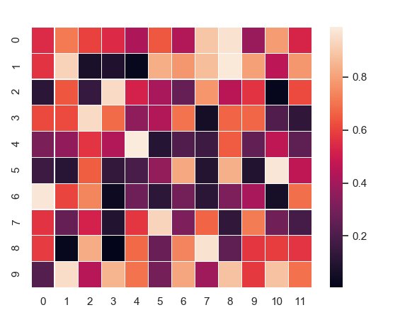
Vector Space

Slide 7
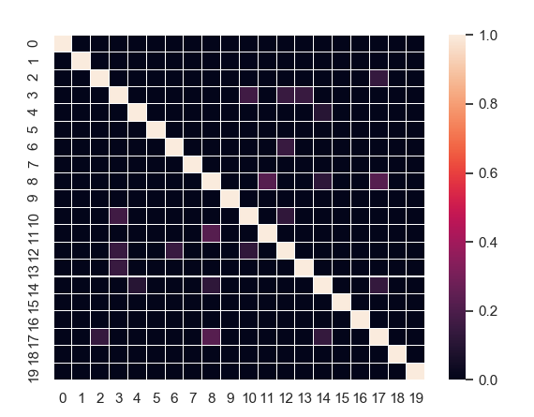
Document Similarity

Slide 8
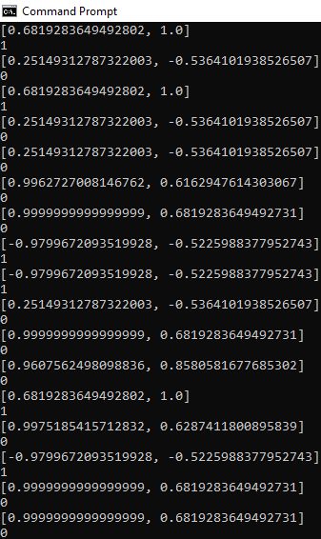
K- means Cluster 2 clusters Results

Slide 9
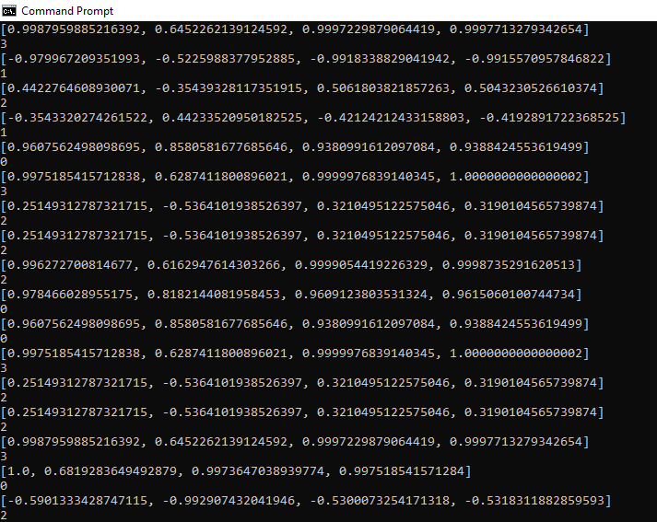
K- means Cluster 4 clusters Results

Slide 10
Hierarchical Clustering of Documents - Single Link

Slide 11
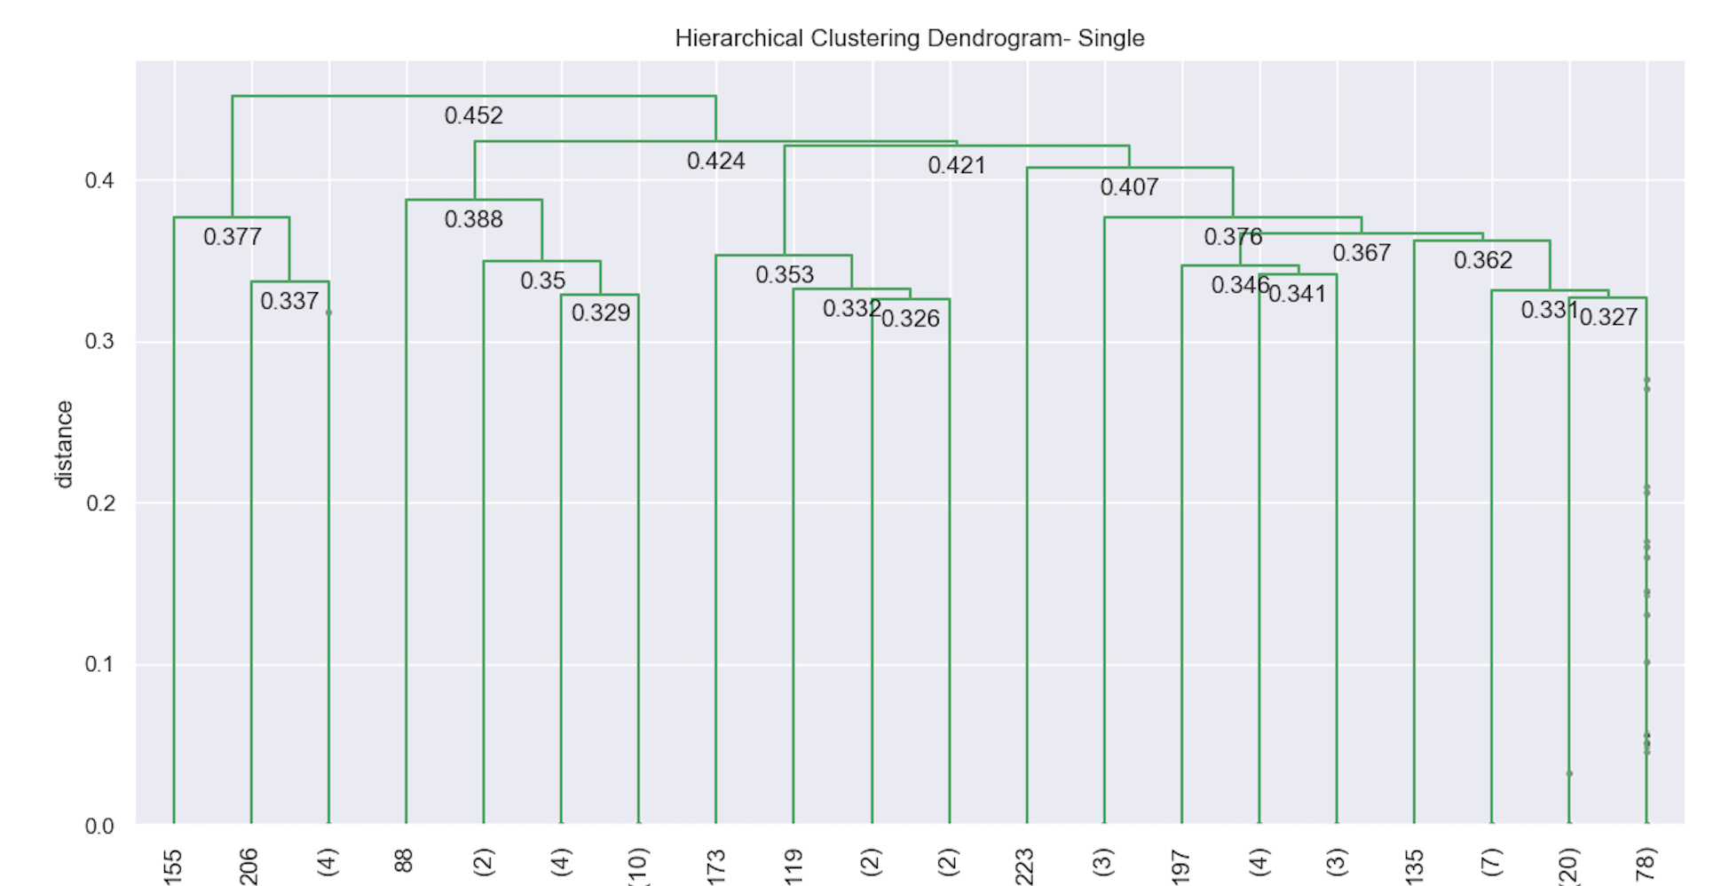
Hierarchical Clustering of Documents - Single Link (cont.)

Slide 12
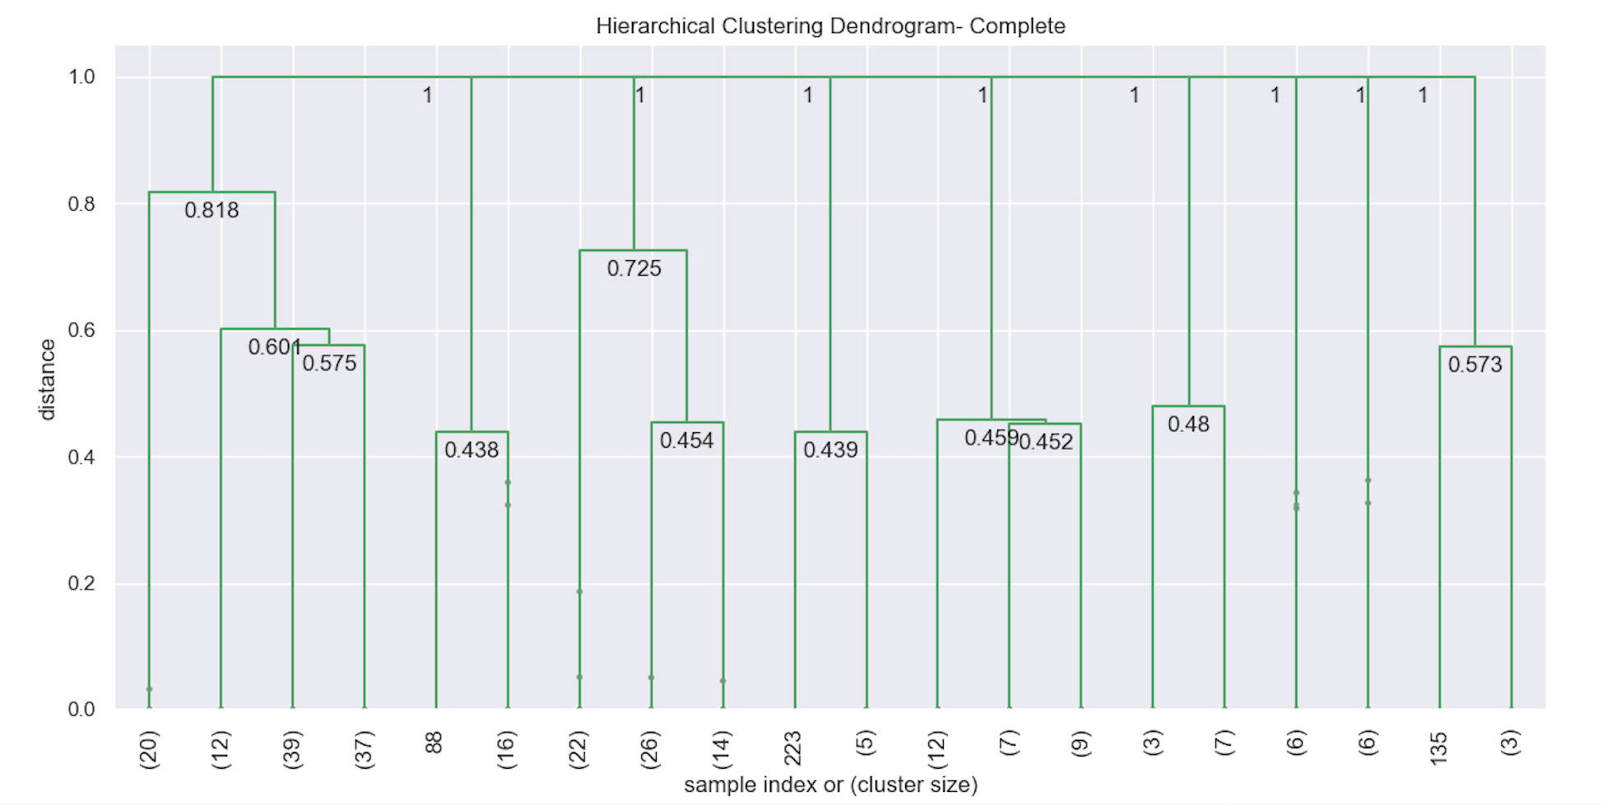
Hierarchical Clustering of Documents - Complete Link

Slide 13
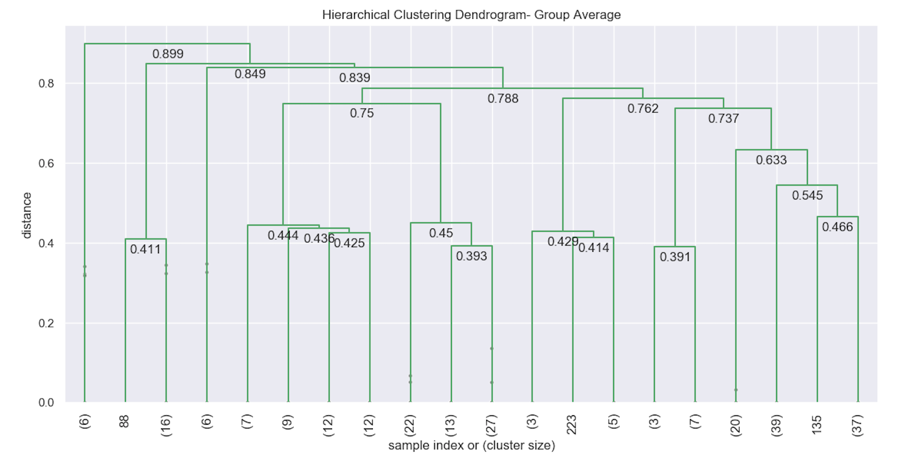
Hierarchical Clustering of Documents - Group Average

Slide 14
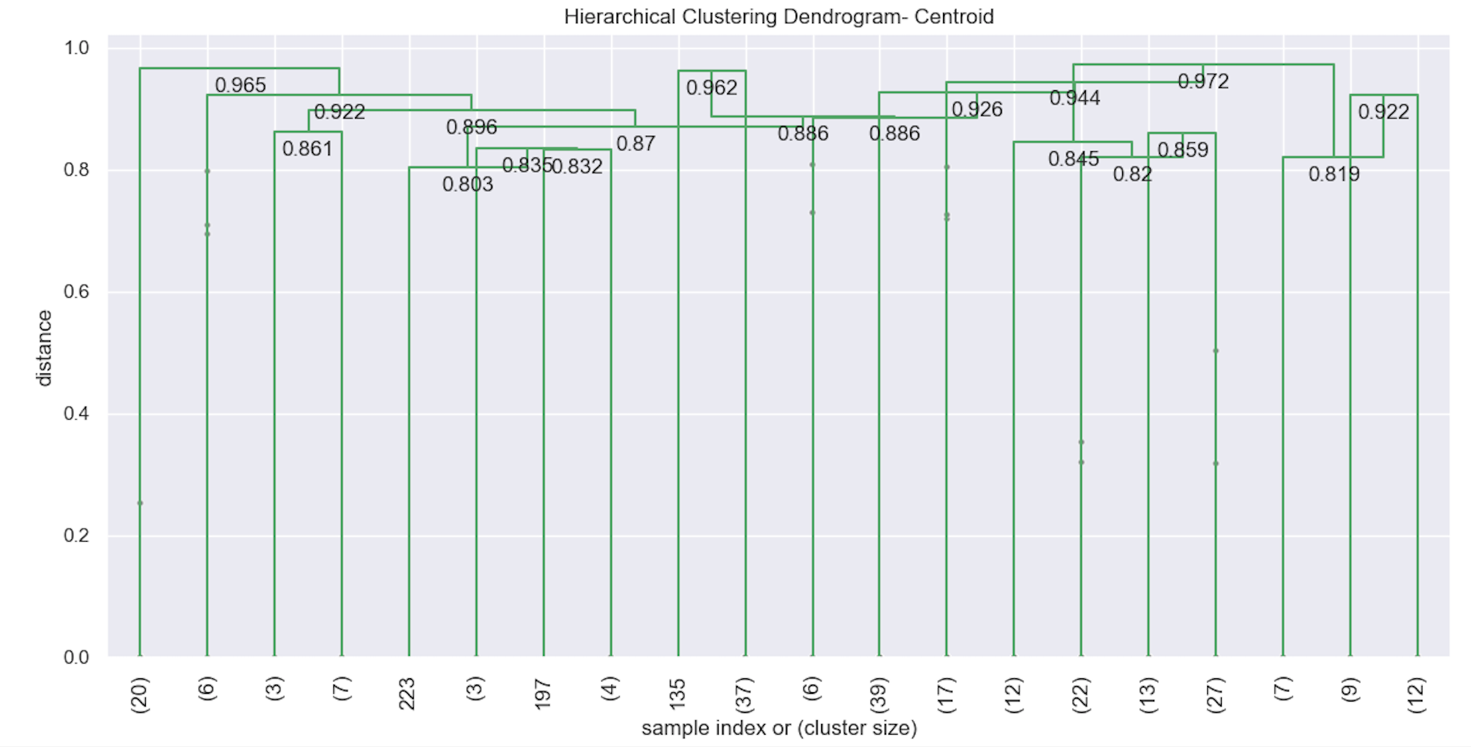
Hierarchical Clustering of Documents - Centroid - Euclidean distance

Slide 15


